Slide 1
BRITISH AIRWAYS
ANALYSING CUSTOMER REVIEW DATA
Presented by:
Ramana Kulanthaivelu

Slide 2
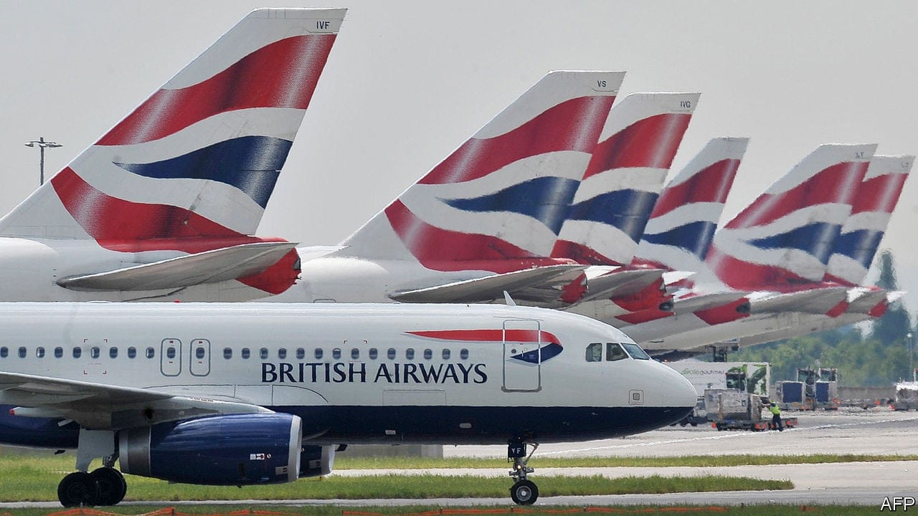
Introduction:
We are pleased to invite you to our presentation, "Analysing Customer Sentiment: British Airways Reviews." We'll look at the opinions that travellers have had about British Airways today. Gaining insight from customer feedback is essential to raising overall satisfaction and service quality. We want to use sentiment analysis to find important information that will enable British Airways to better serve its customers and exceed their expectations. Come along as we explore the feelings that travellers have to share and get insightful knowledge that will spur positive change.

Slide 3
Objectives
Recognising Customer Attitude: Examine the attitude stated in customer testimonials to determine the general perception of British Airways.
Finding Common Topics and Themes: To determine areas of strength and areas for development, identify common topics and themes that are mentioned in the reviews.
Customer satisfaction is influenced by a number of factors, including food quality, service, comfort of the seat, and in-flight entertainment.
Providing Actionable Insights: Based on the sentiment analysis results, give British Airways actionable insights and recommendations to improve business performance and the customer experience.
Trends to Watch: Keep an eye on shifts in consumer attitude over time to spot new patterns and take preventative action when necessary.

Slide 4
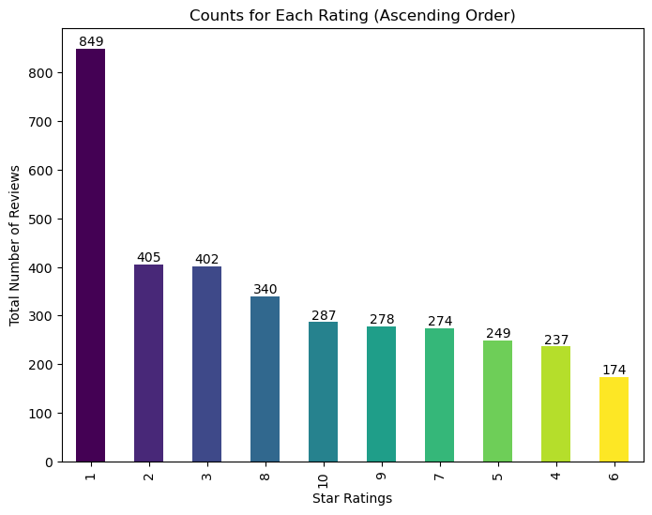
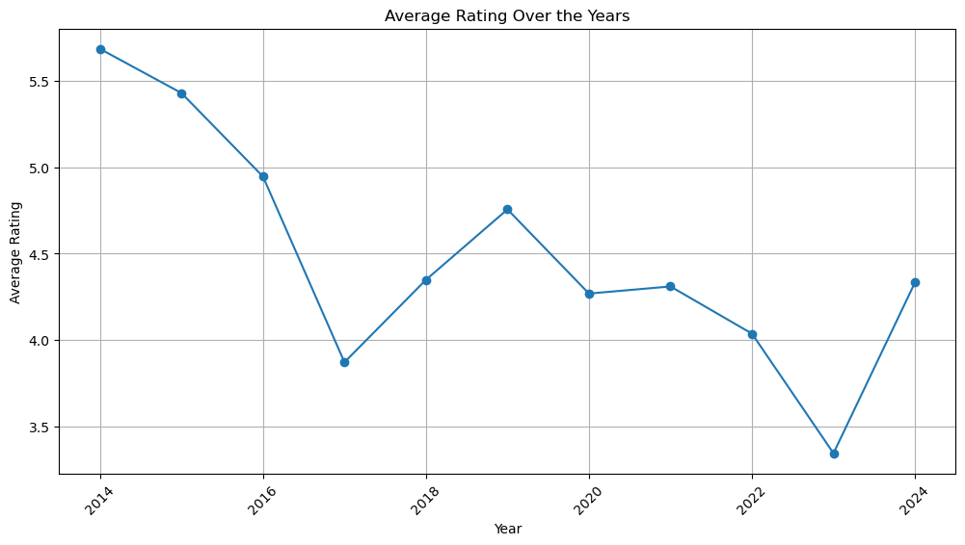
Result overview:
Overall Ratings:
4.6 / 10

Slide 5
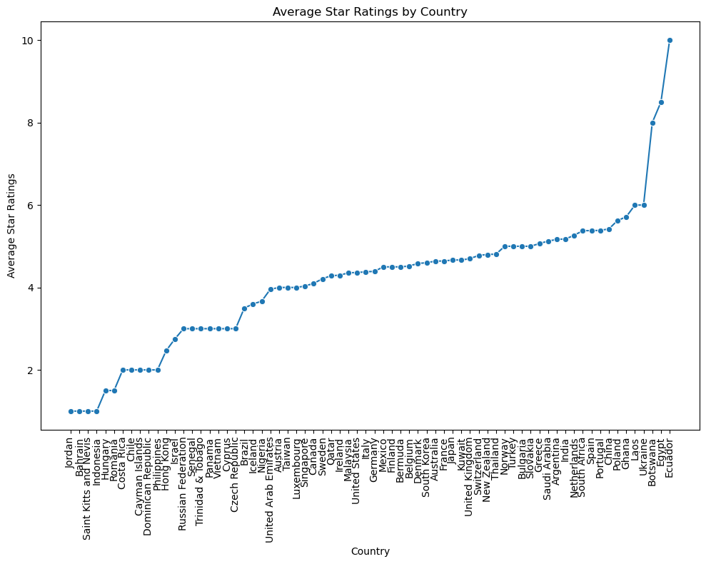
Reviews according to countries:

Slide 6
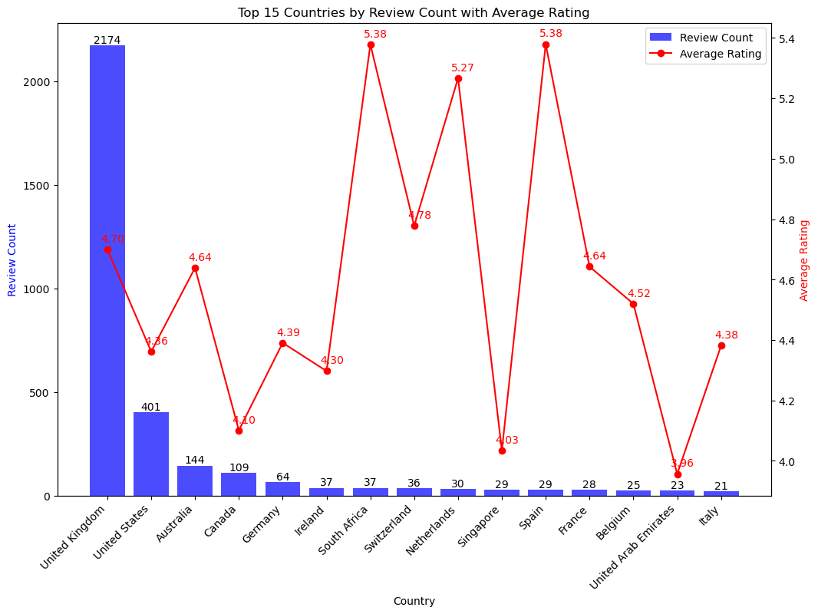

Slide 7
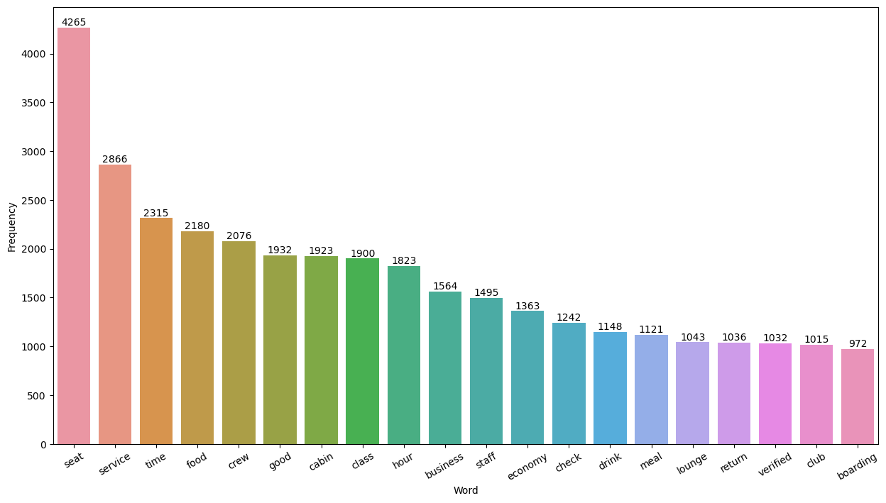
An examination of the word frequency in British Airways reviews provides important information about the opinionsof customers. "Seat" comes up as the most talked about feature, emphasising how important comfortable seating is. Terms like "food," "service," and "crew" highlight how crucial staff conduct and service quality are. Furthermore, the terms "cabin," "class," and "business" allude to preferences for different travel classes and cabin conditions. Additionally, the terms "economy," "check," and "lounge" provided details about particular travel encounters. All things considered, this analysis offers British Airways insightful information about how to better understand customer perceptions and improve the overall travel experience.

Slide 8
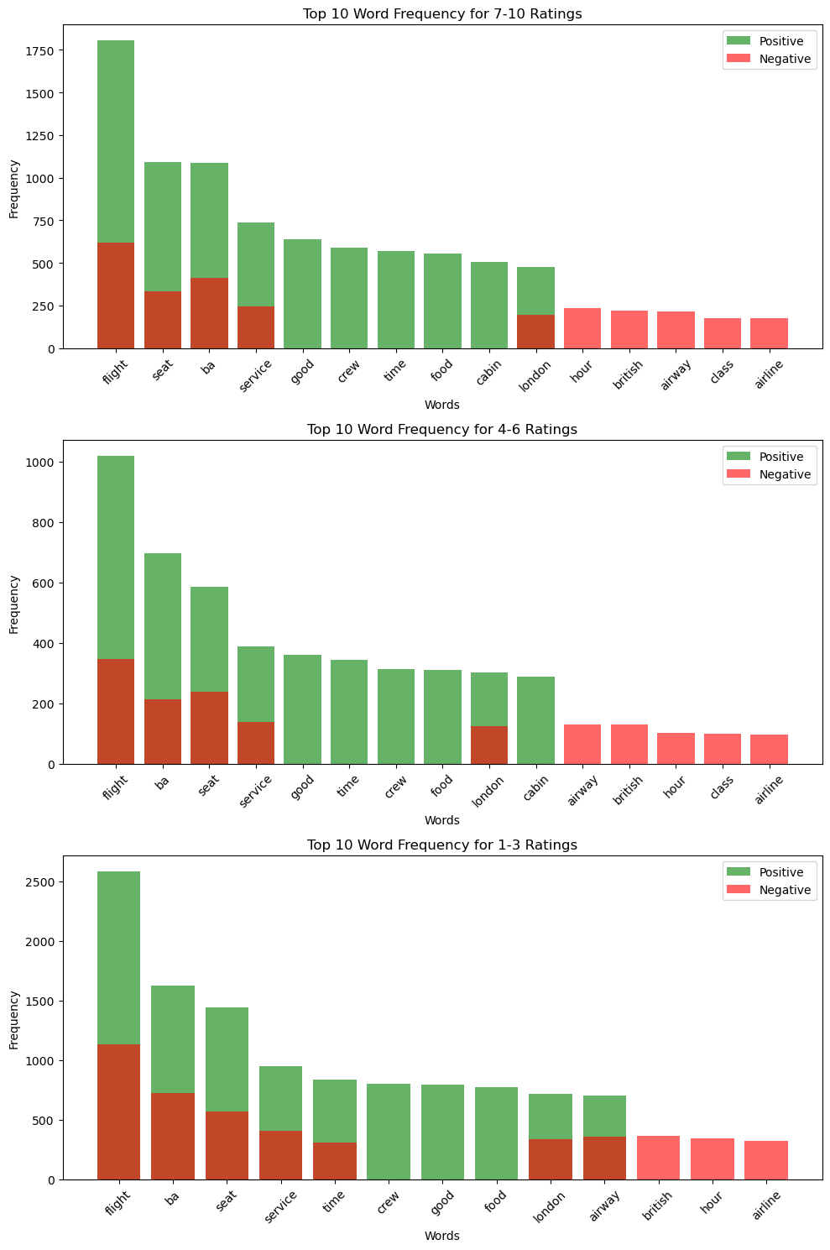
The top 10 word frequencies for each of the three rating groups—7–10 (highest),4-6 (moderate), and 1-3 (lowest)—are displayed in the graph. Red bars indicate negative words, and green bars indicate positive ones. "Flight" leads positively and "hour" leads negatively in the 7–10 range. "Flight" has a positive dominance in 4-6 and a negative dominance in 1-3.The terms "seat," "bag," "service," and "food" are common to all of the groups. Higher ratings tend to reflect positive attitudes, while lower ratings tend to reflect more negativity. Terms associated with flights are frequently used, representing the experiences of travellers over a wide range of ratings.

Slide 9
Key findings and Insights:
The examination of reviews written by customers of British Airways in various rating categories shows clear trends in their opinions and experiences.
Positive features like prompt check-in, amiable service, and cosy seating are emphasised in the rating group of 7–10.
On the other hand, reviews with lower ratings (1-3) voice discontent with things like crammed seats, inadequate service, and unforeseen difficulties encountered while travelling.
The ratings in the 4-6 range are a mixed bag; there are some good comments about the quality of the food and the comfort of the seats, but there are also some bad ones about the unfriendly staff and the mediocre service.
All things considered, the analysis emphasises how critical comfort, dependability, and customer service are in influencing travellers' opinions of the airline.

Slide 10
Recommendations:
British Airways should concentrate on raising customer service standards in light of the findings, especially when it comes to resolving concerns about unfriendly staff behaviour and service quality.
Enhancing the comfort of one's seat and reducing unforeseen obstacles while travelling can also improve the overall traveller experience.
Customer satisfaction may also be increased by funding employee training initiatives and putting policies in place to expedite the boarding and check-in procedures.
British Airways can strive to provide consistently positive experiences across all rating categories and uphold its standing as a top airline in the sector by giving priority to these areas.

